Slide 1

Natural Language Processing
Rohit Kate
Introduction to Machine Learning

Slide 2
What is Machine Learning?
What is learning?
- Converting experience into expertise
What is machine learning?
- Converting experience into expertise by a machine
- More concretely, automatically learning a model (expertise) from past data (experience) to make predictions

Slide 3
Business Applications
Stock market prediction: Predict tomorrow’s stock prices based on economic factors and past records
Price prediction: Predict optimal prices (for airlines, hotels etc.) to maximize profits based on historical sales records
Seasonal changes
Predict if a loan will default
Predict if a credit card transaction is fraud
…

Slide 4
Medical Applications
Medical diagnosis
What disease is present or whether a particular disease is present?
Predicting disease susceptibility
Is the patient likely to get a particular disease?
Predicting prognosis
Whether the patient will recover/survive?
Dosage prediction
Predict optimal dosages based on past data about dosages and outcomes
…

Slide 5
Other Applications
Recognize spoken words
Speech recognition devices, automated phone menus
Recognize handwritten letters
Example: Recognize zip codes on letters for automatic processing
Document Classification
Email is spam or not spam
Sentiment analysis of reviews (classify reviews as good/bad)
…

Slide 6
Machine Learning: Terminology
What is being predicted is called target
Data is represented in terms of features
Pairs of features and target are called examples or instances
Machine learning learns relationship between features and target from given examples, also called training data or training examples
The relationship must generalize to examples not seen during training!

Slide 7
Machine Learning
Machine Learning Method
Logistic regression
Decision Trees
Neural networks
Naïve Bayes
…….
Training
Training Data
Features Target
_ _ _ _ _ _ _ _
_ _ _ _ _ _ _ _
Example 1
_ _ _ _ _ _ _ _
Example 2
…
_ _ _ _ _ _ _ _
_ _ _ _ _ _ _ _
_ _ _ _ _ _ _ _
Target
Prediction
Features
Predictive Model
Example
(never seen before)
Testing

Slide 8
Features and Target of Various Applications
Stock market prediction
Target: Stock price
Features: Economic factors
Predict if a credit card transaction is fraud
Target: Fraud or no fraud
Features: Details of a transaction
Classify emails as spam or no spam
Target: Spam or no spam
Features: Email text
Recognize spoken words
Target: Spoken word
Features: Features from sound signals
Recognize handwritten letters/digits
Target: Letter or number
Features: Features from images

Slide 9
Features and Target of Various Applications
Medical diagnosis
Target: Disease
Features: Patient symptoms, physiological data
Predicting disease susceptibility
Target: Will get a particular disease or not
Features: Patient data from past and present
Predicting prognosis
Target: Will recover/survive or not
Features: Current patient data
Detect cancer in radiology images
Target: Cancer or no cancer
Features: Features from images

Slide 10
When do we need machine learning?
When the tasks are too complex to program
Tasks performed by humans/animals
Image understanding
Speech recognition
Driving
…

Slide 11

Task: Digit Recognition
Task: Given an image of a digit, classify it out of zero to nine.
Seven
Output
Input
For the computer, the task is more like:
0.12 0.22 0.21 0.11 0.23 0.11 0.10 0.09
0.11 0.11 0.21 0.11 0.12 0.17 0.19 0.18
0.12 0.89 0.99 0.77 0.68 0.67 0.23 0.12
0.11 0.34 0.12 0.23 0.34 0.86 0.23 0.11
0.13 0.22 0.21 0.33 0.78 0.12 0.11 0.13
0.12 0.12 0.23 0.89 0.54 0.22 0.12 0.12
Seven

Slide 12
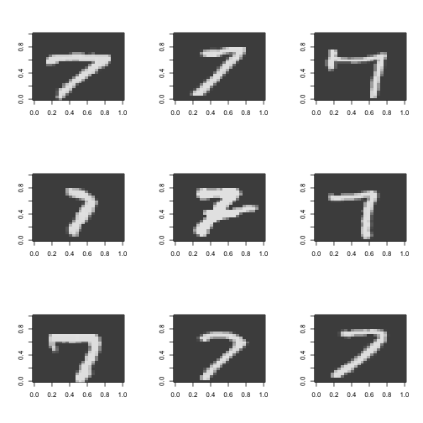
Task: Digit Recognition
How will you write manual rules to recognize, say seven?
Will those rules capture all types of sevens?
Difficult to manually come up with such rules!

Slide 13
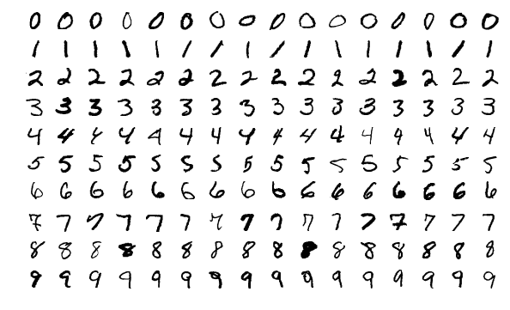
Task: Digit Recognition
How will machine learning be used to build a model for digit recognition?
Machine Learning
Learned model to
recognize digits
Training Data
(typically 1000s of examples)

Slide 14
When do we need machine learning?
When the tasks are too complex to program
Tasks beyond human capabilities
Very large complex datasets, for e.g., with millions of examples and thousands of features
astronomical data, medical archives, data from internet, etc.
When adaptivity is required
Task changes over time or from one user to another
Adapt to new email spams
Adapt to variations in handwriting
Adapt speech recognition to user’s speech
…

Slide 15
When do we NOT need machine learning?
Should we use machine learning to:
Predict area of a circle from its radius
Predict electric current given voltage and resistance
Predict when the next solar eclipse will occur
Machine learning is needless when analytic solutions already exist for a task
For e.g., when phenomenon that can be physically modelled
Each of the above cases, weather forecasting, etc.
Machine learning is also useless when there are no apparent features that are indicative of the target
Predict who will win the lottery

Slide 16
Two Basic Steps of Machine Learning
Training: System learns a model from examples of features
paired with their corresponding targets
Testing: System predicts targets for novel examples (given
their features)
The computer (machine) learns from examples, hence it is
called machine learning. As opposed to humans directly
encoding knowledge into the computer.
Fundamental assumption: Training and test examples are
from the same distribution of data.
Machine learning will not work otherwise!

Slide 17
Example Machine Learning Task
Given a text with the word “line” in it, predict the correct sense of “line” out of the following six senses:
Cord
Division
Formation
Phone
Product
Text

Slide 18
Example Machine Learning Task
Examples:
“While he wouldn’t estimate the sale price, analysts have estimated that it would exceed $1 billion. Kraft also told analysts it plans to develop and test a line of refrigerated entrees and desserts, under the Chillery brand name.”
Product
“C-LD-R L-V-S V-NNA reads a sign in Caldor’s book department. The 1,000 or so people fighting for a place in line have no trouble filling in the blanks.”
Formation
“Newspaper editor Francis P. Church became famous for a 1897 editorial, addressed to a child, that included the line “Yes, Virginia, there is a Santa Clause.”
Text
Cord? Division? Formation? Phone? Product? Text?

Slide 19
Example Machine Learning Task
Examples:
“It is known as an aggressive, tenacious litigator. Richard D. Parsons, a partner at Patterson, Belknap, Webb and Tyler, likes the experience of opposing Sullivan & Cromwell to “having a thousand-pound tuna on the line.”
Cord
“Today, it is more vital than ever. In 1983, the act was entrenched in a new constitution, which established a tricameral parliament along racial lines, whith separate chambers for whites, coloreds and Asians but none for blacks.”
Division
“On the tape recording of Mrs. Guba's call to the 911 emergency line, played at the trial, the baby sitter is heard begging for an ambulance.”
Phone
Cord? Division? Formation? Phone? Product? Text?

Slide 20
Word Sense Disambiguation(WSD) “line” Corpus
Example WSD corpus
4,149 examples from newspaper articles containing the word “line”
Each instance of “line” labeled with one of 6 senses from WordNet
Each example includes a sentence containing “line” and the previous sentence for context
https://www.d.umn.edu/~tpederse/Data/original.line.tar.gz
Note: This was an early dataset we are using for illustration; modern WSD is not done with a separate dataset for each word.

Slide 21
Example Machine Learning Task
Use every word as a feature
Can remove very common words (called stopwords)
Can stem or lemmatize words to remove variations
Use the number of occurrences of a word as its numerical feature value
Or alternatively use presence or absence of the word as its binary feature value

Slide 22
Example Machine Learning Task
Target: From past data
Training Examples
Example | busy | software | access | water | Co | IBM | said | … | Sense
1. | 0 | 0 | 0 | 0 | 0 | 0 | 0 | ... | cord
2. | 1 | 1 | 0 | 1 | 1 | 0 | 2 | … | phone
3. | 0 | 0 | 0 | 0 | 0 | 0 | 0 | … | phone
4. | 0 | 1 | 0 | 0 | 0 | 1 | 0 | … | product
5. | 0 | 0 | 1 | 0 | 0 | 0 | 0 | … | division
…
Features
Feature
values

Slide 23
Example Machine Learning Task
Training Examples
Example | busy | software | access | water | Co | IBM | said | … | Sense
1. | 0 | 0 | 0 | 0 | 0 | 0 | 0 | ... | cord
2. | 1 | 1 | 0 | 1 | 1 | 0 | 2 | … | phone
3. | 0 | 0 | 0 | 0 | 0 | 0 | 0 | … | phone
4. | 0 | 1 | 0 | 0 | 0 | 1 | 0 | … | product
5. | 0 | 0 | 1 | 0 | 0 | 0 | 0 | … | division
…
Unknown
(to be predicted)
Test Examples
Example | busy | software | access | water | Co | IBM | said | … | Sense
1. | 0 | 0 | 1 | 1 | 0 | 0 | 0 | … | ???
2. | 0 | 0 | 0 | 0 | 0 | 1 | 0 | … | ???
3. | 0 | 0 | 0 | 0 | 0 | 0 | 0 | … | ???
…

